Slide 1

ABFRL Brands-Account Flow App Tagging
11th Oct 2023

Slide 2
Guidelines to Implement Tagging
Adobe Launch SDK should be installed before the custom tagging.
Copy and paste the keys of contextData as it is without changing the Camel Casing.
Context Data should be along with calling the Track State and Track Action functions.
<> this indicates dynamic value to be captured and passed.
Icid will be added to the next page’s URL where user lands after clicking any content of current page.
Testing will be performed by Implementation Team after ABFRL QA team will give the confirmation/sign off for the testing done by them.
UAT should be done first in staging and then in production post production UAT adobe’s codes are pushed to live.
For Customer ID, pass the value only when available else pass it as blank.

Slide 3
Super App Brands
Since Super App contains multiple cross-brands journey, therefore w.r.t to tracking the brand/product brand currently included( PFB the table with the expected value to be passed in the context data)
Brand/Product Brand | Datalayer Value
Van Huesen | vh
Peter England | pe
Allen Solly | as
Louis Phillipe | lp
Reebok | rbk
American Eagle | aeo
Forever 21 | f21
Simon Carter | sc

Slide 4
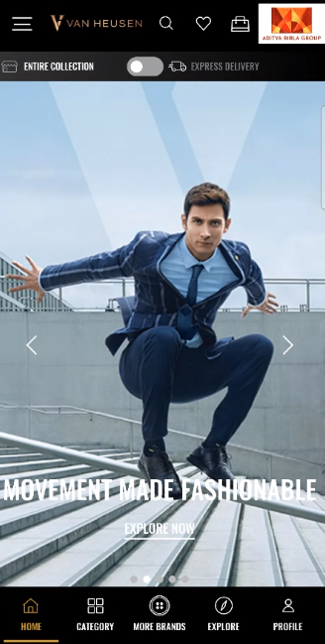
On click on my profile

Slide 5
click type | Tracking type | Launch variables | Expected values
CTA clicks | button | let contextData={ linkName: “my profile", channel: "<android/ios>|<current page name>",// page name without word “name” from where user clicked on my account icon linkPageName: “<current page name>", // page name from where user clicked on my account icon. customerID : "<customerID>", // only pass when available loginStatus : "<logged-in/guest>" , platform: "<android/ios>", userDetails: "<gender>|<age>", // pass only when user is logged in dob: "<date of birth>" // pass only when user is logged in }; ACPCore.trackAction(“my profile", contextData); | loginStatus may have the values:- logged-in Guest

Slide 6
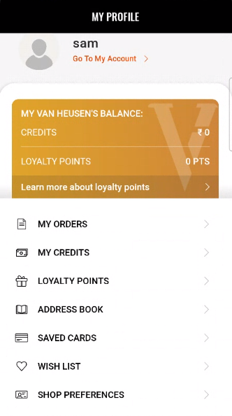
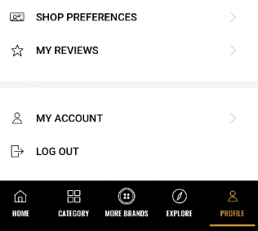
On load of my profile

Slide 7
Page type | Tracking type | Launch variables | Expected values
Profile page | On load | let contextData={ pageName: “profile page", channel: "<android/ios>|my account", customerID : "<customerID>", // only pass when available loginStatus : "<logged-in/guest>" , pageType : “my account - profile page”, //my account-<current page name> platform: "<android/ios>", userDetails: "<gender>|<age>", // pass only when user has logged in dob: "<date of birth>" // pass only when user is logged in // pass only when user has logged in }; ACPCore.trackState(“profile page", contextData); | loginStatus may have the values:- logged-in Guest

Slide 8
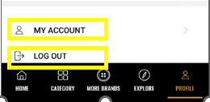
On click of My Account Options

Slide 9
click type | Tracking type | Launch variables | Expected values
Account Options | button | let contextData={ linkName: “<cta click>", channel: "<android/ios>|my account", linkPageName: “profile page”, customerID : "<customerID>", // only pass when available loginStatus : "<logged-in/guest>" , platform: "<android/ios>", userDetails: "<gender>|<age>", // pass only when user is logged in dob: "<date of birth>" // pass only when user is logged in }; ACPCore.trackAction(“<cta click>", contextData); | loginStatus may have the values:- logged-in Guest

Slide 10
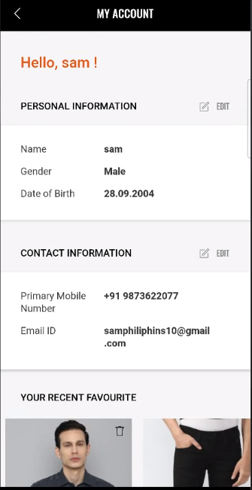
On load of my account

Slide 11
Page type | Tracking type | Launch variables | Expected values
Account page | On load | let contextData={ pageName: “my account page", channel: "<android/ios>|my account", customerID : "<customerID>", // only pass when available loginStatus : "<logged-in/guest>" , pageType : “my account - my account page”, //my account-< current page Name> platform: "<android/ios>", userDetails: "<gender>|<age>", // pass only when user has logged in dob: "<date of birth>" // pass only when user is logged in // pass only when user has logged in }; ACPCore.trackState(“my account page", contextData); | loginStatus may have the values:- logged-in Guest

Slide 12
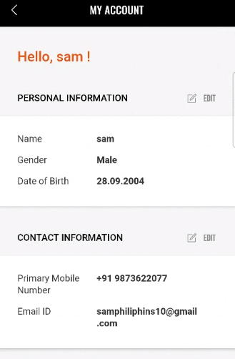
On all CTA clicks

Slide 13
click type | Tracking type | Launch variables | Expected values
All CTA | button | let contextData={ linkName:“<cta name>", channel: "<android/ios>|my account", linkPageName: “my account page", customerID : "<customerID>", // only pass when available loginStatus : "<logged-in/guest>" , platform: "<android/ios>", userDetails: "<gender>|<age>", // pass only when user is logged in dob: "<date of birth>" // pass only when user is logged in }; ACPCore.trackAction(“<cta name>", contextData); | loginStatus may have the values:- logged-in Guest

Slide 14
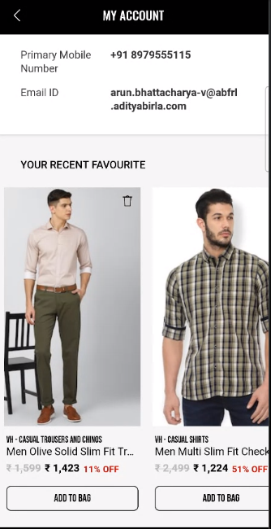
Remove Product from wishlist

Slide 15
click type | Tracking type | Launch variables | Expected values
CTA clicks | icon | let contextData={ linkName: “remove from wishlist", channel: "<android/ios>|my account", linkPageName: “my account page", customerID : "<customerID>", // only pass when available &&events: “event5” // event5 only when remove from Wishlist &&products : ";<product id>;;;;eVar19 = <product category>|eVar30=<product name>|eVar32=<product brand name>”,​ loginStatus : "<logged-in/guest>", platform: "<android/ios>", userDetails: "<gender>|<age>", // pass only when user is logged in dob: "<date of birth>" // pass only when user is logged in }; ACPCore.trackAction(“remove from wishlist", contextData); | loginStatus may have the values:- logged-in Guest productID: will have the value of SKU ID of the product. productCategory: will have the category of the product. Example:- shirt trouser productName: name of the product.

Slide 16
On product click

Slide 17
click type | Tracking type | Launch variables | Expected values
CTA clicks | widget | let contextData={ linkName: “product click", channel: "<android/ios>|my account", linkPageName: “my account page", customerID : "<customerID>", // only pass when available loginStatus : "<logged-in/guest>", &&products : ";<product id>;;;;eVar19 = <product category>|eVar30=<product name>|eVar32=<product brand name>|eVar33=<product stock status>|eVar35=<product size>|eVar23=<product position>”, pfm : “<section of the page/ product finding source>”, platform: "<android/ios>", userDetails: "<gender>|<age>", // pass only when user is logged in dob: "<date of birth>" // pass only when user is logged in }; ACPCore.trackAction(“product click", contextData); | loginStatus may have the values:- logged-in Guest productID: will have the value of SKU ID of the product. productCategory: will have the category of the product. Example:- shirt trouser productName: name of the product. stockStatus: provide whether product is in stock or out of stock eg – stockStatus : “out of stock” or “available” brandName: name of the brand of the product.

Slide 18
On clicking on Add to bag

Slide 19
click type | Tracking type | Launch variables | Expected values
Add to bag | Button | let contextData={ linkName: "add to bag", channel: "<android/ios>|my account", linkPageName: “my account page", customerID : "<customerID>", // only pass when available loginStatus : "<logged-in/guest>" , &&events: "scAdd, event13, event14, event15, event61", &&products : ";<product id>;;;event13=<product marked price>|event14=<product selling price>|event15=<product discount amount>|event61=<product quantity>;eVar19 = <product category>|eVar30=<product name>|eVar32=<product brand name>|eVar33=< product stock Status>|eVar34= <product color>|eVar35=<product size>|eVar36=< product genderType>|eVar44=<product style code>", platform: "<android/ios>", userDetails: "<gender>|<age>", // pass only when user is logged in dob: "<date of birth>" // pass only when user is logged in }; ACPCore.trackAction("add to bag", contextData); | loginStatus may have the values:- logged-in guest In brand, the expected values are f21 sc productID: will have the value of SKU ID of the product. productCategory: will have the category of the product. Example:- Shirt Trouser productMarkPrice: will contain the MRP of the product. productSellPrice: will contain the actual selling price of the product. productQuantity: will have the quantity selected for the product. productName: name of the product. brandName: name of the brand of the product. stockStatus: it will show the quantity of the product available in the stock. color: example values: Red. size: example values:- 42 L styleCode: will contain the style code of the product. Example value:- PESFONUB236782 productDiscount will have the discount applied on the product. productGenderType Example value:- Female

Slide 20
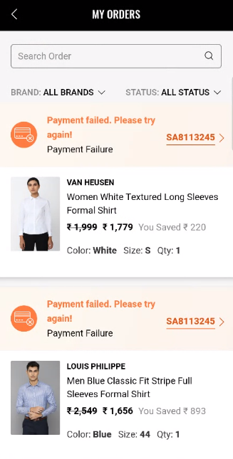
On load of My Orders page

Slide 21
Page type | Tracking type | Launch variables | Expected values
My orders | On load | let contextData={ pageName: “my orders page", channel: "<android/ios>|my account", customerID : "<customerID>", // only pass when available loginStatus : "<logged-in/guest>" , pageType : “my account - my orders page”, //my account-<pageName> platform: "<android/ios>", userDetails: "<gender>|<age>", // pass only when user has logged in dob: "<date of birth>" // pass only when user is logged in // pass only when user has logged in }; ACPCore.trackState(“my orders page", contextData); | loginStatus may have the values:- logged-in Guest

Slide 22
On all CTA clicks

Slide 23
click type | Tracking type | Launch variables | Expected values
CTA clicks | button | let contextData={ linkName:“<cta name>", channel: "<android/ios>|my account", linkPageName: “my orders page", customerID : "<customerID>", // only pass when available loginStatus : "<logged-in/guest>" , platform: "<android/ios>", userDetails: "<gender>|<age>", // pass only when user is logged in dob: "<date of birth>" // pass only when user is logged in }; ACPCore.trackAction(“<cta name>", contextData); | loginStatus may have the values:- logged-in Guest <cta name> on order ID click will be “order id click”

Slide 24
On Product Click

Slide 25
click type | Tracking type | Launch variables | Expected values
CTA clicks | button | let contextData={ linkName: “product click", channel: "<android/ios>|my account", linkPageName: “my orders page", customerID : "<customerID>", // only pass when available loginStatus : "<logged-in/guest>", &&products : ";<product id>;;;;eVar19 = <product category>|eVar30=<product name>|eVar32=<product brand name>|eVar33=<product stock status>|eVar35=<product size>|eVar23=<product position>”, pfm : “<section of the page/ product finding source>”, platform: "<android/ios>", userDetails: "<gender>|<age>", // pass only when user is logged in dob: "<date of birth>" // pass only when user is logged in }; ACPCore.trackAction(“product click", contextData); | loginStatus may have the values:- logged-in Guest

Slide 26
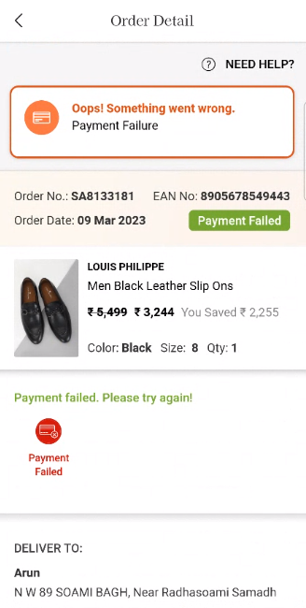
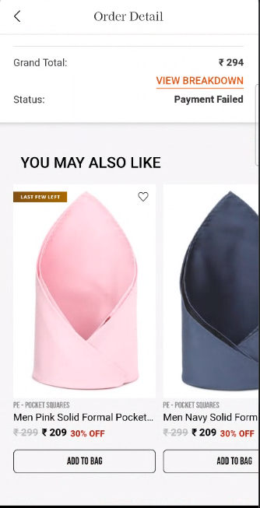
On load of Order Detail Page

Slide 27
Page type | Tracking type | Launch variables | Expected values
Order Detail | On load | let contextData={ pageName: “order detail page", channel: "<android/ios>|my account", customerID : "<customerID>", // only pass when available loginStatus : "<logged-in/guest>" , pageType : “my account - order detail page”, //my account - <pageName> platform: "<android/ios>", userDetails: "<gender>|<age>", // pass only when user has logged in dob: "<date of birth>" // pass only when user is logged in // pass only when user has logged in }; ACPCore.trackState(“order detail page", contextData); | loginStatus may have the values:- logged-in Guest

Slide 28
On all CTA clicks

Slide 29
click type | Tracking type | Launch variables | Expected values
CTA clicks | button | let contextData={ linkName:“<cta name>", channel: "<android/ios>|my account", linkPageName: “order detail page", customerID : "<customerID>", // only pass when available loginStatus : "<logged-in/guest>" , platform: "<android/ios>", userDetails: "<gender>|<age>", // pass only when user is logged in dob: "<date of birth>" // pass only when user is logged in }; ACPCore.trackAction(“<cta name>", contextData); | loginStatus may have the values:- logged-in Guest <cta name> on order ID click will be “order id click”

Slide 30
On product click

Slide 31
click type | Tracking type | Launch variables | Expected values
CTA clicks | widget | let contextData={ linkName: “product click", channel: "<android/ios>|my account", linkPageName: “order detail page", customerID : "<customerID>", // only pass when available loginStatus : "<logged-in/guest>", &&products : ";<product id>;;;;eVar19 = <product category>|eVar30=<product name>|eVar32=<product brand name>|eVar33=<product stock status>|eVar35=<product size>|eVar23=<product position>”, pfm : “<section of the page/ product finding source>”, platform: "<android/ios>", userDetails: "<gender>|<age>", // pass only when user is logged in dob: "<date of birth>" // pass only when user is logged in }; ACPCore.trackAction(“product click", contextData); | loginStatus may have the values:- logged-in Guest productID: will have the value of SKU ID of the product. productCategory: will have the category of the product. Example:- shirt trouser productName: name of the product. stockStatus: provide whether product is in stock or out of stock eg – stockStatus : “out of stock” or “available” brandName: name of the brand of the product.

Slide 32
On Order Detail Wishlist click

Slide 33
click type | Tracking type | Launch variables | Expected values
Add to Wishlist | Icon | let contextData={ linkName: "<add to wishlist/remove from wishlist>", channel: "<android/ios>|my account", linkPageName: “order detail page", customerID : "<customerID>", // only pass when available loginStatus : "<logged-in/guest>", &&events: “<event4/event5>” // event4 only when add to Wishlist and event5 only when remove from Wishlist &&products : ";<product id>;;;;eVar19 = <product category>|eVar30=<product name>|eVar32=<product brand name>”, platform: "<android/ios>", userDetails: "<gender>|<age>", // pass only when user is logged in dob: "<date of birth>" // pass only when user is logged in }; ACPCore.trackAction("<add to wishlist/remove from wishlist>",contextData); | loginStatus may have the values:- logged-in guest In brand, the expected values are f21 sc productID: will have the value of SKU ID of the product. productCategory: will have the category of the product. Example:- shirt trouser productName: name of the product.

Slide 34
On clicking on Add to bag

Slide 35
click type | Tracking type | Launch variables | Expected values
Add to bag | Button | let contextData={ linkName: "add to bag", channel: "<android/ios>|my account", linkPageName: “order detail page", customerID : "<customerID>", // only pass when available loginStatus : "<logged-in/guest>" , &&events: "scAdd, event13, event14, event15, event61", &&products : ";<product id>;;;event13=<product marked price>|event14=<product selling price>|event15=<product discount amount>|event61=<product quantity>;eVar19 = <product category>|eVar30=<product name>|eVar32=<product brand name>|eVar33=< product stock Status>|eVar34= <product color>|eVar35=<product size>|eVar36=< product genderType>|eVar44=<product style code>", platform: "<android/ios>", userDetails: "<gender>|<age>", // pass only when user is logged in dob: "<date of birth>" // pass only when user is logged in }; ACPCore.trackAction("add to bag",contextData); | loginStatus may have the values:- logged-in guest In brand, the expected values are f21 sc productID: will have the value of SKU ID of the product. productCategory: will have the category of the product. Example:- Shirt Trouser productMarkPrice: will contain the MRP of the product. productSellPrice: will contain the actual selling price of the product. productQuantity: will have the quantity selected for the product. productName: name of the product. brandName: name of the brand of the product. stockStatus: it will show the quantity of the product available in the stock. color: example values: Red. size: example values:- 42 L styleCode: will contain the style code of the product. Example value:- PESFONUB236782 productDiscount will have the discount applied on the product. productGenderType Example value:- Female

Slide 36
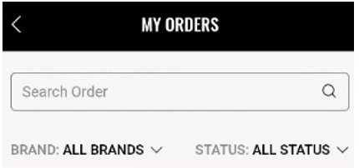
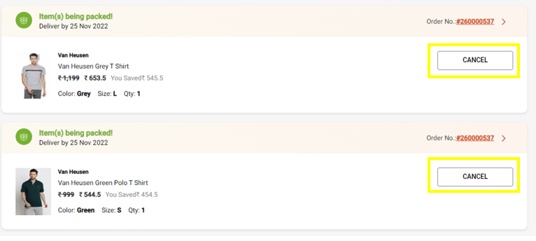
On click of Cancel order

Slide 37
click type | Tracking type | Launch variables | Expected values
CTA clicks | button | let contextData={ linkName: “cancel order", channel: "<android/ios>|my account", linkPageName: “my orders page", customerID : "<customerID>", // only pass when available &&products: “;<product ID>;;;; eVar19 = <product category>|eVar30=<product name>|eVar32=<product brand name>|eVar33=< product stock Status>|eVar35=<product size>”, loginStatus : "<logged-in/guest>" , platform: "<android/ios>", userDetails: "<gender>|<age>", // pass only when user is logged in dob: "<date of birth>" // pass only when user is logged in }; ACPCore.trackAction(“cancel order", contextData); | loginStatus may have the values:- logged-in Guest productID: will have the value of SKU ID of the product. productCategory: will have the category of the product. Example:- shirt trouser productName: name of the product. stockStatus: provide whether product is in stock or out of stock eg – stockStatus : “out of stock” or “available” brandName: name of the brand of the product.

Slide 38
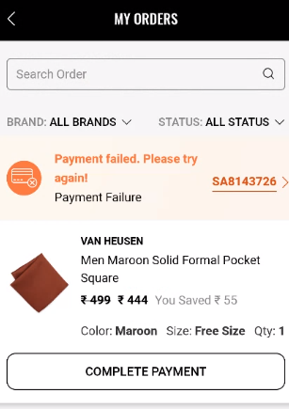
On click of Complete Payment

Slide 39
click type | Tracking type | Launch variables | Expected values
CTA clicks | button | let contextData={ linkName: “complete payment", channel: "<android/ios>|my account", linkPageName: “my orders page", customerID : "<customerID>", // only pass when available loginStatus : "<logged-in/guest>" , platform: "<android/ios>", userDetails: "<gender>|<age>", // pass only when user is logged in dob: "<date of birth>" // pass only when user is logged in }; ACPCore.trackAction(“complete payment", contextData); | loginStatus may have the values:- logged-in Guest productID: will have the value of SKU ID of the product. productCategory: will have the category of the product. Example:- shirt trouser productName: name of the product. stockStatus: provide whether product is in stock or out of stock eg – stockStatus : “out of stock” or “available” brandName: name of the brand of the product.

Slide 40
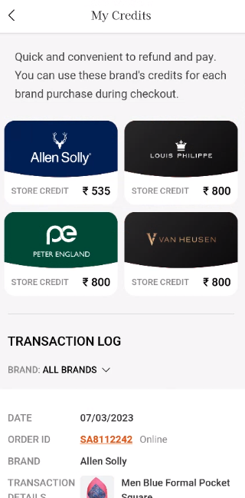
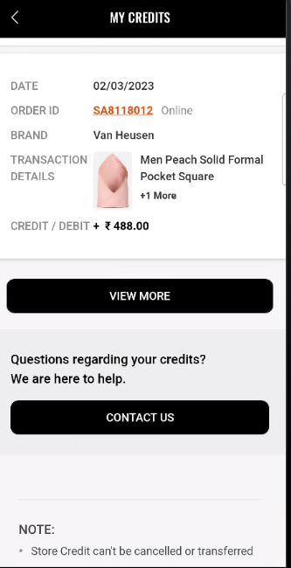
On load of my credits

Slide 41
Page type | Tracking type | Launch variables | Expected values
Credits page | On load | let contextData={ pageName: “my credits page", channel: "<android/ios>|my account", customerID : "<customerID>", // only pass when available loginStatus : "<logged-in/guest>" , pageType : “my account - my credits page”, //my account-<pageName> platform: "<android/ios>", userDetails: "<gender>|<age>", // pass only when user has logged in dob: "<date of birth>" // pass only when user is logged in // pass only when user has logged in }; ACPCore.trackState(“my credits page", contextData); | loginStatus may have the values:- logged-in Guest

Slide 42
On all CTA clicks

Slide 43
click type | Tracking type | Launch variables | Expected values
CTA clicks | button | let contextData={ linkName:“<cta click>", channel:"<android/ios>|my account", linkPageName: “my credits page", customerID : "<customerID>", // only pass when available loginStatus : "<logged-in/guest>" , platform: "<android/ios>", userDetails: "<gender>|<age>", // pass only when user is logged in dob: "<date of birth>" // pass only when user is logged in }; ACPCore.trackAction(“<cta click>", contextData); | loginStatus may have the values:- logged-in Guest

Slide 44
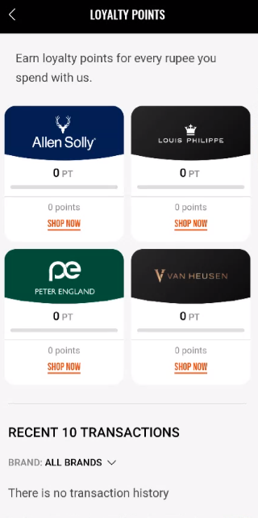
On load of loyalty points page

Slide 45
Page type | Tracking type | Launch variables | Expected values
Loyalty page | On load | let contextData={ pageName: “loyalty page", channel: "<android/ios>|my account", customerID : "<customerID>", // only pass when available loginStatus : "<logged-in/guest>" , pageType : “my account - loyalty page”, //my account-<pageName> platform: "<android/ios>", userDetails: "<gender>|<age>", // pass only when user has logged in dob: "<date of birth>" // pass only when user is logged in // pass only when user has logged in }; ACPCore.trackState(“loyalty page", contextData); | loginStatus may have the values:- logged-in Guest

Slide 46
On all CTA clicks

Slide 47
click type | Tracking type | Launch variables | Expected values
CTA clicks | button | let contextData={ linkName:“<cta click>", channel:"<android/ios>|my account", linkPageName: “loyalty page", customerID : "<customerID>", // only pass when available loginStatus : "<logged-in/guest>" , platform: "<android/ios>", userDetails: "<gender>|<age>", // pass only when user is logged in dob: "<date of birth>" // pass only when user is logged in }; ACPCore.trackAction(“<cta click>", contextData); | loginStatus may have the values:- logged-in Guest

Slide 48
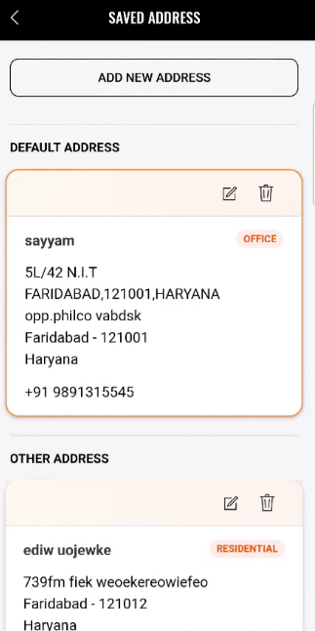
On load of Address book

Slide 49
Page type | Tracking type | Launch variables | Expected values
Address book | On load | let contextData={ pageName: “address book page", channel: "<android/ios>|my account", customerID : "<customerID>", // only pass when available loginStatus : "<logged-in/guest>" , pageType : “my account - address book page”, //my account-<pageName> platform: "<android/ios>", userDetails: "<gender>|<age>", // pass only when user has logged in dob: "<date of birth>" // pass only when user is logged in // pass only when user has logged in }; ACPCore.trackState(“address book page", contextData); | loginStatus may have the values:- logged-in Guest

Slide 50
On CTA clicks

Slide 51
Click type | Tracking type | Launch variables | Expected values
All CTA | button | let contextData={ linkName: “<cta click>", channel: "<android/ios>|my account", linkPageName: “address book page", customerID : "<customerID>", loginStatus : “<logged-in/guest>" , platform: "<android/ios>", userDetails: "<gender>|<age>", dob: "<date of birth>“, }; ACPCore.trackAction(“<cta click>", contextData); | loginStatus may have the values:- logged-in Guest

Slide 52
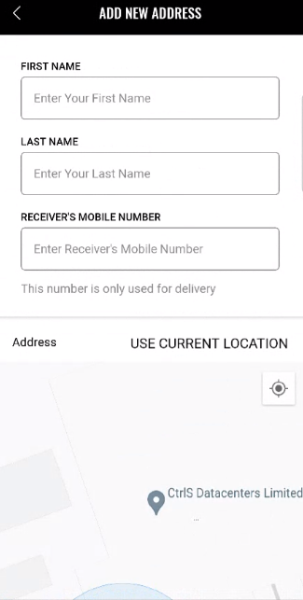
On load of add new address page

Slide 53
Page Type | Tracking Type | Launch variables | Expected Values
New Address Form | View | let contextData={ pageName: “add address page", channel:"<android/ios>|my account", customerID : "<customerID>", parentPage: “address book page”, loginStatus : "logged-in" , pageType : “my account - address book page”, //my account-<pageName> platform: "<android/ios>", userDetails: "<gender>|<age>", dob: "<date of birth>" }; ACPCore.trackState(“add address page", contextData); | loginStatus may have the values:- logged-in guest

Slide 54
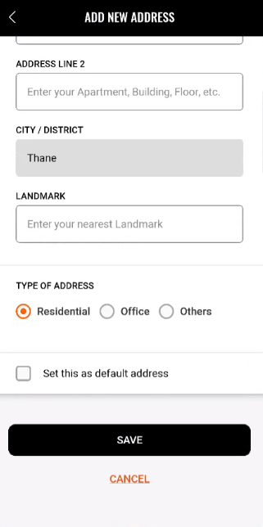
On all CTA clicks

Slide 55
click type | Tracking type | Launch variables | Expected values
CTA clicks | button | let contextData={ linkName: "<cta name>", channel:"<android/ios>|my account", linkPageName: “add address page", customerID : "<customerID>", parentPage: “address book page”, loginStatus : "logged-in" , platform: "<android/ios>", userDetails: "<gender>|<age>", dob: "<date of birth>" }; ACPCore.trackAction(“<cta click>", contextData); | loginStatus may have the values:- logged-in Guest

Slide 56
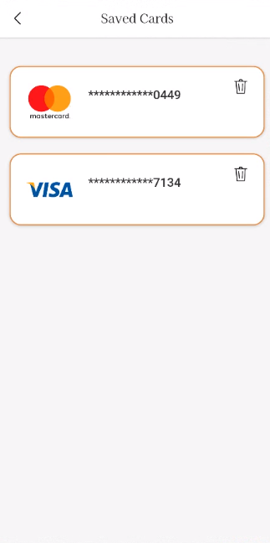
On load of saved cards

Slide 57
Page type | Tracking type | Launch variables | Expected values
Saved cards Page | On load /update | let contextData={ pageName: “saved cards page", channel: "<android/ios>|my account", customerID : "<customerID>", // only pass when available loginStatus : "<logged-in/guest>" , pageType : “my account - saved cards page”, //my account-<pageName> platform: "<android/ios>", userDetails: "<gender>|<age>", // pass only when user has logged in dob: "<date of birth>" // pass only when user is logged in // pass only when user has logged in }; ACPCore.trackState(“saved cards page", contextData); | loginStatus may have the values:- logged-in Guest

Slide 58
On all CTA clicks

Slide 59
click type | Tracking type | Launch variables | Expected values
CTA clicks | button | let contextData={ linkName:“<cta clicks>", channel:"<android/ios>|my account", linkPageName: “saved cards page", customerID : "<customerID>", // only pass when available loginStatus : "<logged-in/guest>" , platform: "<android/ios>", userDetails: "<gender>|<age>", // pass only when user is logged in accountPaymentMethod: “< payment method>”, //payment method deleted dob: "<date of birth>" // pass only when user is logged in }; ACPCore.trackAction(“<cta clicks>", contextData); | loginStatus may have the values:- logged-in Guest <payment method> may have Visa American express, etc.

Slide 60
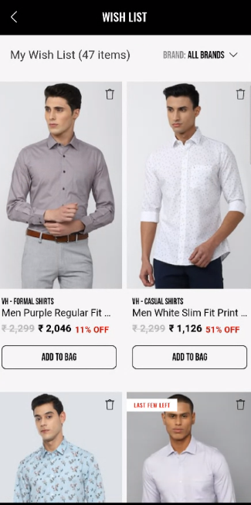
On load of wishlist

Slide 61
Page type | Tracking type | Launch variables | Expected values
Wishlist page | On load | let contextData={ pageName: “wishlist page", channel: "<android/ios>|my account", customerID : "<customerID>", // only pass when available loginStatus : "<logged-in/guest>" , pageType : “my account - wishlist page”, //my account-<pageName> platform: "<android/ios>", userDetails: "<gender>|<age>", // pass only when user has logged in dob: "<date of birth>" // pass only when user is logged in // pass only when user has logged in }; ACPCore.trackState(“wishlist page", contextData); | loginStatus may have the values:- logged-in Guest

Slide 62
On all CTA clicks

Slide 63
click type | Tracking type | Launch variables | Expected values
CTA clicks | button | let contextData={ linkName:“<cta clicks>", channel: "<android/ios>|my account", linkPageName: “wishlist page", customerID : "<customerID>", // only pass when available loginStatus : "<logged-in/guest>" , platform: "<android/ios>", userDetails: "<gender>|<age>", // pass only when user is logged in dob: "<date of birth>" // pass only when user is logged in }; ACPCore.trackAction(“<cta clicks>", contextData); | loginStatus may have the values:- logged-in Guest

Slide 64
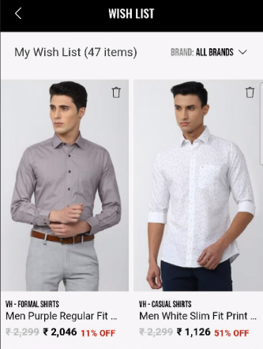
Remove Product from Wishlist

Slide 65
click type | Tracking type | Launch variables | Expected values
CTA clicks | icon | let contextData={ linkName: “remove from wishlist", channel: "<android/ios>|my account", linkPageName: “wishlist page", customerID : "<customerID>", // only pass when available &&events: “event5” // event5 only when remove from Wishlist &&products : ";<product id>;;;;eVar19 = <product category>|eVar30=<product name>|eVar32=<product brand name>”,​ loginStatus : "<logged-in/guest>", platform: "<android/ios>", userDetails: "<gender>|<age>", // pass only when user is logged in dob: "<date of birth>" // pass only when user is logged in }; ACPCore.trackAction(“remove from wishlist", contextData); | loginStatus may have the values:- logged-in Guest productID: will have the value of SKU ID of the product. productCategory: will have the category of the product. Example:- shirt trouser productName: name of the product.

Slide 66
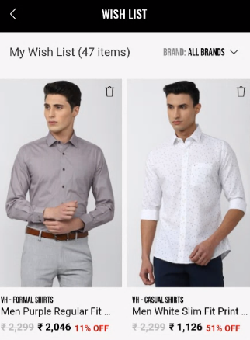
On product click

Slide 67
click type | Tracking type | Launch variables | Expected values
CTA clicks | widget | let contextData={ linkName: “product click", channel: "<android/ios>|my account", linkPageName: “wishlist page", customerID : "<customerID>", // only pass when available loginStatus : "<logged-in/guest>", &&products : ";<product id>;;;;eVar19 = <product category>|eVar30=<product name>|eVar32=<product brand name>|eVar33=<product stock status>|eVar35=<product size>|eVar23=<product position>”, pfm : “<section of the page/ product finding source>”, platform: "<android/ios>", userDetails: "<gender>|<age>", // pass only when user is logged in dob: "<date of birth>" // pass only when user is logged in }; ACPCore.trackAction(“product click", contextData); | loginStatus may have the values:- logged-in Guest productID: will have the value of SKU ID of the product. productCategory: will have the category of the product. Example:- shirt trouser productName: name of the product. stockStatus: provide whether product is in stock or out of stock eg – stockStatus : “out of stock” or “available” brandName: name of the brand of the product.

Slide 68
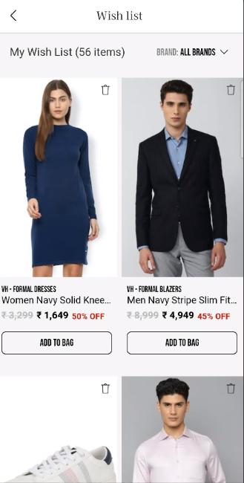
On clicking on Add to bag

Slide 69
click type | Tracking type | Launch variables | Expected values
Add to bag | Button | let contextData={ linkName: "add to bag", channel: "<android/ios>|my account", linkPageName: “wishlist page", customerID : "<customerID>", // only pass when available loginStatus : "<logged-in/guest>" , &&events: "scAdd, event13, event14, event15, event61", &&products : ";<product id>;;;event13=<product marked price>|event14=<product selling price>|event15=<product discount amount>|event61=<product quantity>;eVar19 = <product category>|eVar30=<product name>|eVar32=<product brand name>|eVar33=< product stock Status>|eVar34= <product color>|eVar35=<product size>|eVar36=< product genderType>|eVar44=<product style code>", platform: "<android/ios>", userDetails: "<gender>|<age>", // pass only when user is logged in dob: "<date of birth>" // pass only when user is logged in }; ACPCore.trackAction("add to bag", contextData); | loginStatus may have the values:- logged-in guest In brand, the expected values are f21 sc productID: will have the value of SKU ID of the product. productCategory: will have the category of the product. Example:- Shirt Trouser productMarkPrice: will contain the MRP of the product. productSellPrice: will contain the actual selling price of the product. productQuantity: will have the quantity selected for the product. productName: name of the product. brandName: name of the brand of the product. stockStatus: it will show the quantity of the product available in the stock. color: example values: Red. size: example values:- 42 L styleCode: will contain the style code of the product. Example value:- PESFONUB236782 productDiscount will have the discount applied on the product. productGenderType Example value:- Female

Slide 70
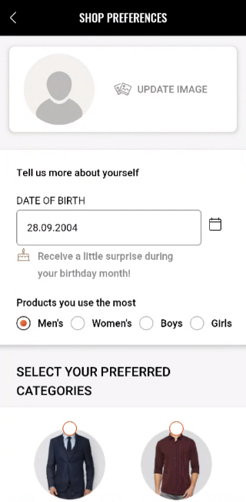
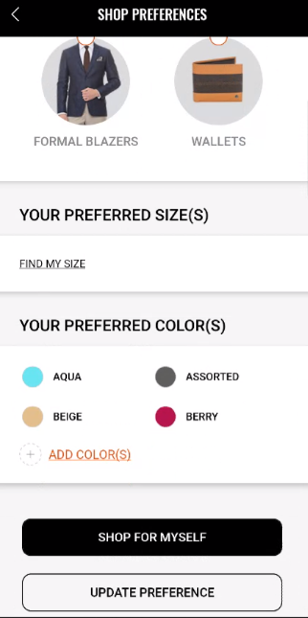
On load of shop preferences

Slide 71
Page type | Tracking type | Launch variables | Expected values
Shop preferences | On load | let contextData={ pageName: “shop preferences page", channel: "<android/ios>|my account", customerID : "<customerID>", // only pass when available loginStatus : "<logged-in/guest>" , pageType : “my account - shop preferences page”, //my account-<pageName> platform: "<android/ios>", userDetails: "<gender>|<age>", // pass only when user has logged in dob: "<date of birth>" // pass only when user is logged in // pass only when user has logged in }; ACPCore.trackState(“shop preferences page", contextData); | loginStatus may have the values:- logged-in Guest

Slide 72
On CTA Click

Slide 73
click type | Tracking type | Launch variables | Expected values
CTA clicks | button | let contextData={ linkName: “<cta click>", channel: "<android/ios>|my account", linkPageName: “shop preferences page", customerID : "<customerID>", // only pass when available loginStatus : "<logged-in/guest>", platform: "<android/ios>", userDetails: "<gender>|<age>", // pass only when user is logged in dob: "<date of birth>" // pass only when user is logged in }; ACPCore.trackAction(“<cta click>", contextData); | loginStatus may have the values:- logged-in Guest

Slide 74
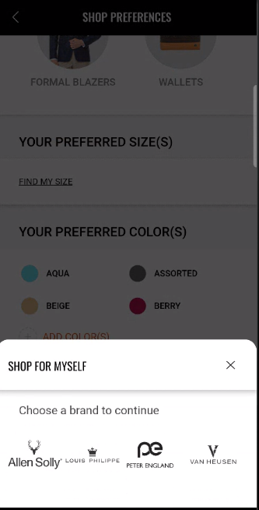
On Selecting Brand

Slide 75
click type | Tracking type | Launch variables | Expected values
Shop for myself | icon | digitalData={ linkName: “<brand name>", channel: "<android/ios>|my account", linkPageName: “shop preferences page", customerID : "<customerID>", // only pass when available loginStatus : "<logged-in/guest>", platform: "<android/ios>", userDetails: "<gender>|<age>", // pass only when user is logged in dob: "<date of birth>" // pass only when user is logged in }; ACPCore.trackAction(“<brand name>", contextData); | loginStatus may have the values:- logged-in Guest

Slide 76
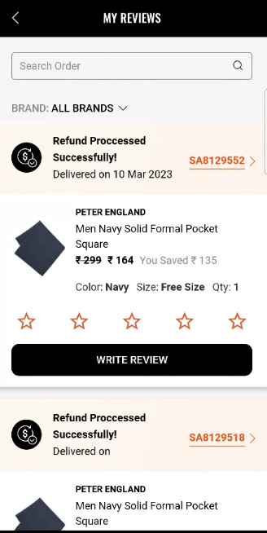
On load of my reviews

Slide 77
Page type | Tracking type | Launch variables | Expected values
Reviews | On load | let contextData={ pageName: “my reviews page", channel: "<android/ios>|my account", customerID : "<customerID>", // only pass when available loginStatus : "<logged-in/guest>" , pageType : “my account - my reviews page”, //my account-<pageName> platform: "<android/ios>", userDetails: "<gender>|<age>", // pass only when user has logged in dob: "<date of birth>" // pass only when user is logged in // pass only when user has logged in }; ACPCore.trackState(“my reviews page", contextData); | loginStatus may have the values:- logged-in Guest

Slide 78
On CTA clicks

Slide 79
click type | Tracking type | Launch variables | Expected values
CTA clicks | button | let contextData={ linkName: “<cta click>", channel: "<android/ios>|my account", linkPageName: “my reviews page", customerID : "<customerID>", // only pass when available loginStatus : "<logged-in/guest>", platform: "<android/ios>", userDetails: "<gender>|<age>", // pass only when user is logged in dob: "<date of birth>" // pass only when user is logged in }; ACPCore.trackAction(“<cta click>", contextData); | loginStatus may have the values:- logged-in Guest

Slide 80
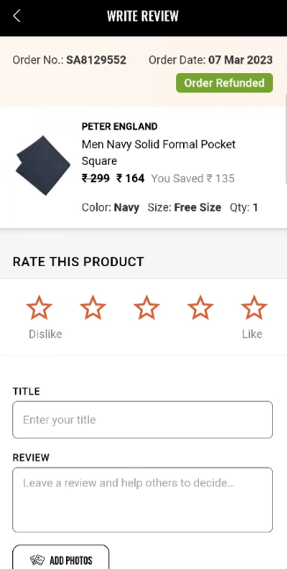
On load of write review

Slide 81
Page type | Tracking type | Launch variables | Expected values
Write review | On load | let contextData={ pageName: “write review page", channel: "<android/ios>|my account", customerID : "<customerID>", // only pass when available loginStatus : "<logged-in/guest>" , pageType : “my account - write review page”, //my account-<pageName> platform: "<android/ios>", userDetails: "<gender>|<age>", // pass only when user has logged in dob: "<date of birth>" // pass only when user is logged in // pass only when user has logged in }; ACPCore.trackState(“write review page", contextData); | loginStatus may have the values:- logged-in Guest

Slide 82
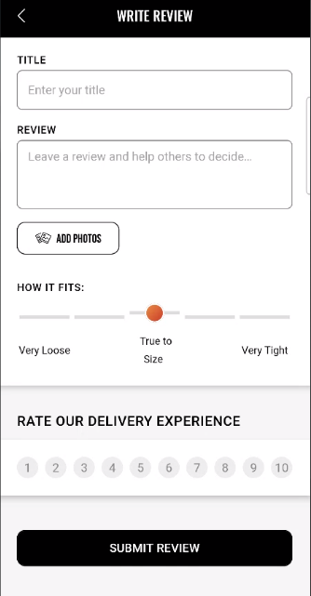
On CTA clicks

Slide 83
click type | Tracking type | Launch variables | Expected values
CTA clicks | button | let contextData={ linkName: “<cta click>", channel: "<android/ios>|my account", linkPageName: “write review page", customerID : "<customerID>", // only pass when available loginStatus : "<logged-in/guest>", platform: "<android/ios>", userDetails: "<gender>|<age>", // pass only when user is logged in dob: "<date of birth>" // pass only when user is logged in }; ACPCore.trackAction(“<cta click>", contextData); | loginStatus may have the values:- logged-in Guest

